Slide 1

Amazon Sales Dashboard Analysis
Business & Financial Insights Presentation

Slide 2
Problem Statement
The organization lacks a centralized, interactive reporting system to monitor and analyse its sales performance across product categories, regions, and payment methods. Decision-makers currently rely on static reports, making it difficult to identify trends, top-performing products, discount effectiveness, and customer behavior in real time.
Using the available Amazon sales dataset, the goal is to build a Power BI dashboard that provides clear, actionable insights into revenue, quantity sold, customer ratings, and regional performance.

Slide 3
Vision
The dashboard should enable stakeholders to:
Track total revenue and sales trends over time.
Identify top-selling product categories and products.
Analyse the impact of discounts on revenue and sales volume.
Compare performance across different customer regions.
Evaluate customer satisfaction using ratings and review counts.
Monitor preferred payment methods and their contribution to revenue.
The solution should present these insights through interactive visuals, filters, and KPIs, enabling faster and more informed business decisions.

Slide 4
Business Objective
The objective of this project is to develop an interactive Power BI dashboard that provides insights into sales performance, product demand, customer satisfaction, and regional trends.
The dashboard will help stakeholders make data-driven decisions regarding pricing, inventory, marketing, and customer engagement.

Slide 5
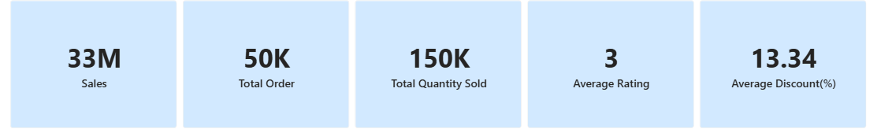
KPI’s
  These are the list of KPI’s used in the visual
  Total Revenue
  Total Orders
  Total Quantity
  Average Rating
  Average Discount(%)

Slide 6
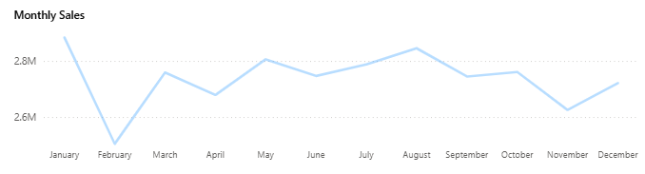
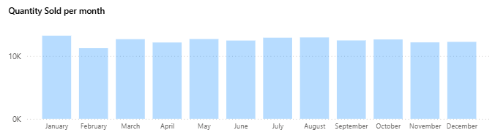
Revenue & Order Insights
Moderate average order value
Stable order volumes across months
Consistent demand across categories
Sales range: ~2.5M to 2.9M per month
Peak around August
Dips in February and November
Overall steady yearly performance

Slide 7
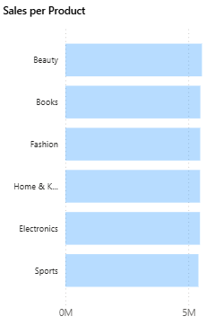
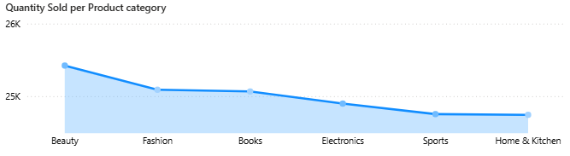
Product Category Performance
Six major categories with balanced sales
Diversified revenue streams
No single dominant category

Slide 8
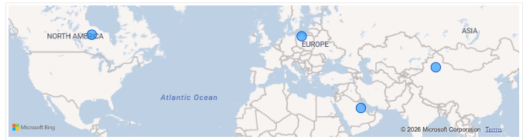
Geographical Sales Insights
Sales across multiple global regions
Presence in North America, Europe, Asia, Middle East
Scope to scale in top markets

Slide 9
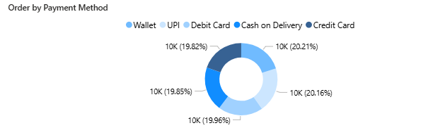
Payment Method Insights
Even distribution across payment types
Wallet, UPI, cards, and COD used equally
Indicates diverse customer preferences

Slide 10
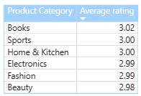
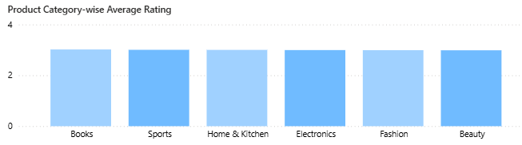
Customer Satisfaction Analysis
Average rating: 3.0
Neutral customer satisfaction level
Opportunity to improve quality and service

Slide 11
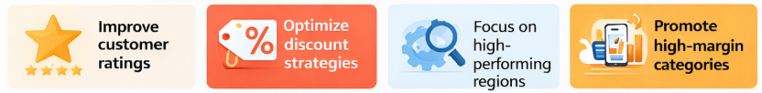
Key Business Opportunities
Improve customer ratings
Optimize discount strategies
Focus on high-performing regions
Promote high-margin categories

Slide 12

Strategic Recommendations
Launch loyalty programs
Enhance product quality
Use targeted promotions
Improve analytics for profitability

Slide 13
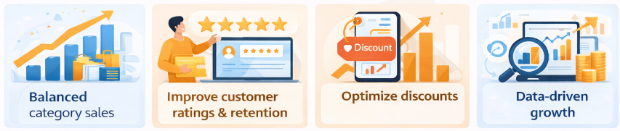
Conclusion & Next Steps
Stable performance with balanced category sales
Focus on improving customer ratings and retention
Optimize discounts to protect margins
Use data-driven strategies for growth

